Slide 1
Table

Slide 2
Agenda
Table
Sample output
Table implementation

Slide 3
Table
Table Tag:
Table tag is used to create tables.
All the data regarding table is inside table tag.
Row Tag:
Used to create new rows in the table. This is used inside Table Tag.
Table Head Tag:
Used to create table header. This is used inside row tag.
Data Tag:
This is used to enter data in row. This is used inside row tag.

Slide 4
Table syntax
Table Tag:
<table>
…..
</table>
Row Tag:
<tr>
….
</tr>
Table Head Tag:
<tr>
<th>Column 1</th>
<th>Column 2</th>
</tr>
Data Tag:
<tr>
<td>Column 1 Data</td>
<td>Column 2 Data</td>
</tr>

Slide 5
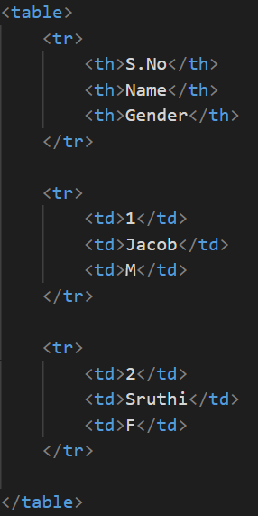
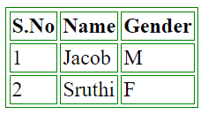
Sample output

Slide 6
Table implementation
Let’s see Table implementation.

Slide 7
Summary
We have seen how to create table in HTML.
We can create as many tables as needed.
DO NOT WRITE ANYTHING
HERE. LEAVE THIS SPACE FOR
WEBCAM

Slide 8
Thank You
Proprietary content. ©Great Learning. All Rights Reserved. Unauthorized use or distribution prohibited

